Slide 1
Victor Reader Trek

Slide 2
What You Get in the Box
• VictorReader Trek device
• USB cable
• Power adaptor
• Belt clip and lanyard
• Small USB cable for support of thumb drives or cartridges
• Headphones
• Weather resistant carrying case
• Getting started sheet

Slide 3
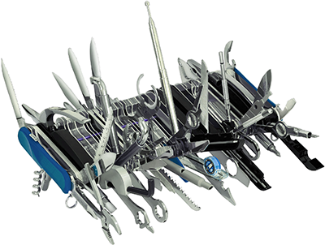
Victor Reader Trek Features
Tactile keypad with simple intuitive structure
Consistency of features and commands
Vibration motor for tactile notification
Explore mode
Support for walking or driving GPS
Support for unmapped areas
Backtrack feature
Route creation and guidance
Landmark creation and guidance
Address and postal code input
Commercial points of interest
Indoor preview a route
Pedometer
Bluetooth support
Internet radio
FM Radio (coming soon)
Multiple GPS systems supported
iBeacon support (for future use)
Where am I feature
Information feature
Support for many book and file formats
Wifi support
TomTom maps
External landmark and POI imports
High volume internal speaker
Voice recorder
External microphone support
Clock
Computer Connection
Companion Software

Slide 4
Battery Life and Charging
Battery life: around 8 hours with GPS enabled (battery life will be significantly less with WiFi, Bluetooth and GPS all enabled)
Recharge time: around 4 hours using USB AC adapter (recharge time will be longer if charging using a USB cable connection to a computer)
Recommended 1 Amp USB Power Adapter When powered off LED indicator will blink and there will be a double vibration to indicate charging. If unit is in use LED will glow instead of blinking
Recommendation is to remove leather carrying case when charging and keep unit away from heat sources
Automatic power off in 30 minutes if left in pause mode, unless you are in Orientation mode.

Slide 5
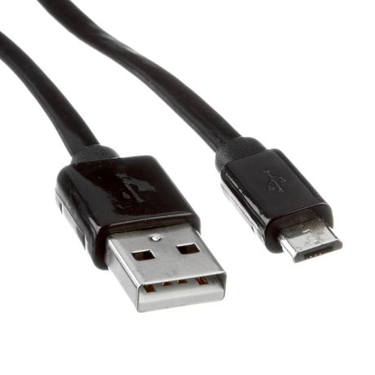
Computer Connections
Micro USB connection to Windows computers
SD Card can be used with reader in Mac computers
Companion software available for Windows only
Allows for transfer of books and documents for reading and playback
Trekker Map Manager software allows backup and restore of landmarks and routes
Also allows importing of GPX and CSV files for importing landmark and POI content

Slide 6
Memory Internal and External
Internal 32 GB storage for operating system, maps and protected books (North America Maps approx. 6GB)
SD Card support up to 256GB (SDXC format) mini and micro SD cards can be used with adapter
USB drives of any size

Slide 7
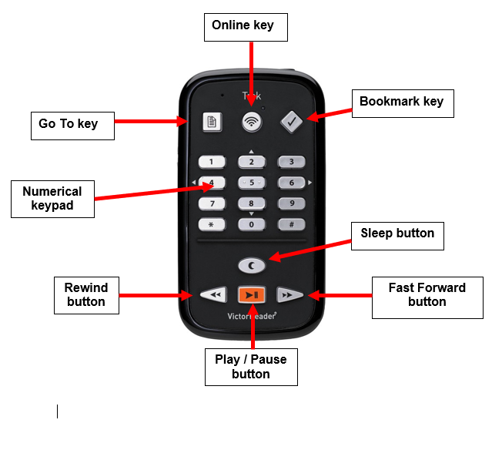
Physical Layout
• Size: 114 x 62 x 24mm (4.5 x 2.4 x 0.9 inches)
• Weight with battery: 140g (5.0 ounces)

Slide 8
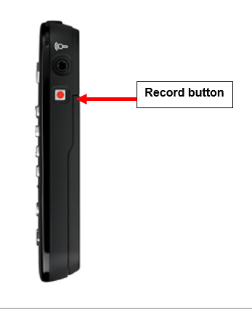
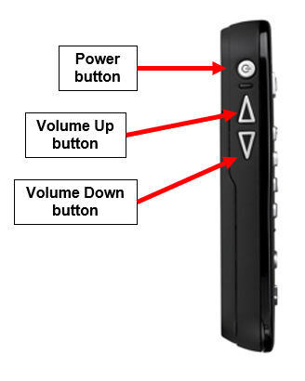
Physical Layout

Slide 9
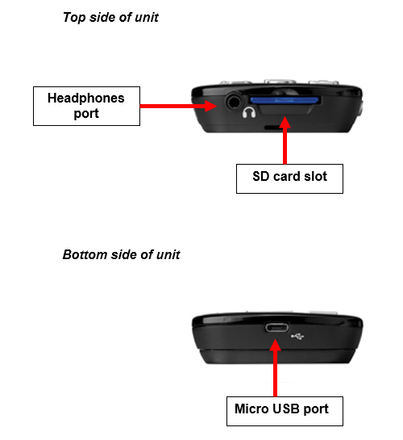
Physical Layout

Slide 10
Supported Languages
English
French
German
Danish
Dutch Flemish
Norwegian
Polish
Russian
Spanish
Swedish
In various combinations depending on the country

Slide 11
Modes of Use
Offline Bookshelf Mode – Working with content on the internal memory, SD card or USB
drive such as DAISY Books, audiobooks, music files, Word docs and podcasts.
Online Bookshelf Mode – Working with internet based content such as internet radio stations,
downloading podcasts, using Wikipedia and Wiktionary text lookup features.
Orientation Mode – GPS navigation including creating routes, recording landmarks and
exploring the environment.

Slide 12
Keypad Functions – Online or Offline Bookshelf Mode
• Key 1- Bookshelf selection / open inbuilt user guide
• Key 2- Go up a navigation level
• Key 3- Copy/delete book from SD card
• Key 4- Move backward an element (at chosen navigation level)
• Key 5- Where Am I - announce current reading position
• Key 6- Move forward an element (at chosen navigation level)
• Key 7- Player configuration menu / toggle TTS voice
• Key 8- Go down a navigation level
• Key 9- Shuffle mode for music / Switch playback mode (toggle between text-to-speech, and recorded DAISY) /
• Key *- Cancel/interrupt an operation
• Key 0- Information key – provides information about current book and Trek device information / Key Describer mode
• Key #- Confirm an operation/start playback

Slide 13
Keypad Functions – Orientation Mode
• Key 1- Open inbuilt user guide
• Key 2- Go up a navigation level
• Key 3- Open landmarks / routes settings
• Key 4- Move back to the previous item in a list (eg. routes or landmarks list)
• Key 5- Where Am I – announce information about current GPS position / What’s Around
– lists landmarks and POIs in current vicinity
• Key 6- Move forward to the next item in a list (eg. routes or landmarks list) / Toggle open area lock
• Key 7- Settings menu
• Key 8- Go down a navigation level
• Key 9- Activate Backtrack function
• Key *- Deactivate route and return to general Explore mode
• Key 0- Information key – provides information about state of the system and Trek device information / Key Describer mode
• Key #- Confirm an operation

Slide 14
Supported File Formats
• Talking Book formats: DAISY 2, 2.02 , NISO Z39.86 2002,/2005, NIMAS 1.1, unprotected EPUB 2, LGK
• Audio codecs: AMR-WB+, mp3, MPEG2, mp4, m4a, m4v, OGG Vorbis, Wav P.C.M, Speex
• All file types / formats: 3gp, bra, brf, docx, fb2, html, m4a, m4v, mp2, mp3, mp4, mpg, OGG, rtf, SES3, txt, wav, xml, LKF
• Recording: MP3 16-bit samples at a sampling rate of 44,100Hz with a bit rate of 64, 96 kbps, PCM 16-bit samples at a sampling rate of 44.100Hz

Slide 15
Global Positioning System (GPS)
Current accuracy of roughly 30 feet
Accuracy effected by
How clear a view of the sky the receiver has
Obstructions such as tall buildings or overhangs
Position of the satellites being tracked
Number of satellites being tracked
Cloud cover or electrical interference from overhead power lines
Speed of the users movement
Treat GPS as if you’re in the middle of the street
Addresses are typically based on percentages if not hard coded on the map data,
Support for GLONASS GPS and upcoming support for Galileo GPS

Slide 16
Carrying the Trek
Shoulder strap recommended
- all functions can generally be performed one-handed
Belt clip included
Lanyard included
Avoid covering the Trek with your hand as this will effect GPS reception
Headphones not recommended for safety reasons – use the external speaker

Slide 17
Power on/off
Power button, left side.
Press and hold 3 seconds. Unit will beep, vibrate and speak a welcome message
Power down by pressing power 3 seconds. Unit will beep twice and vibrate twice
Note: When Trek is turned off it will not turn on again for approximately 30 seconds.

Slide 18
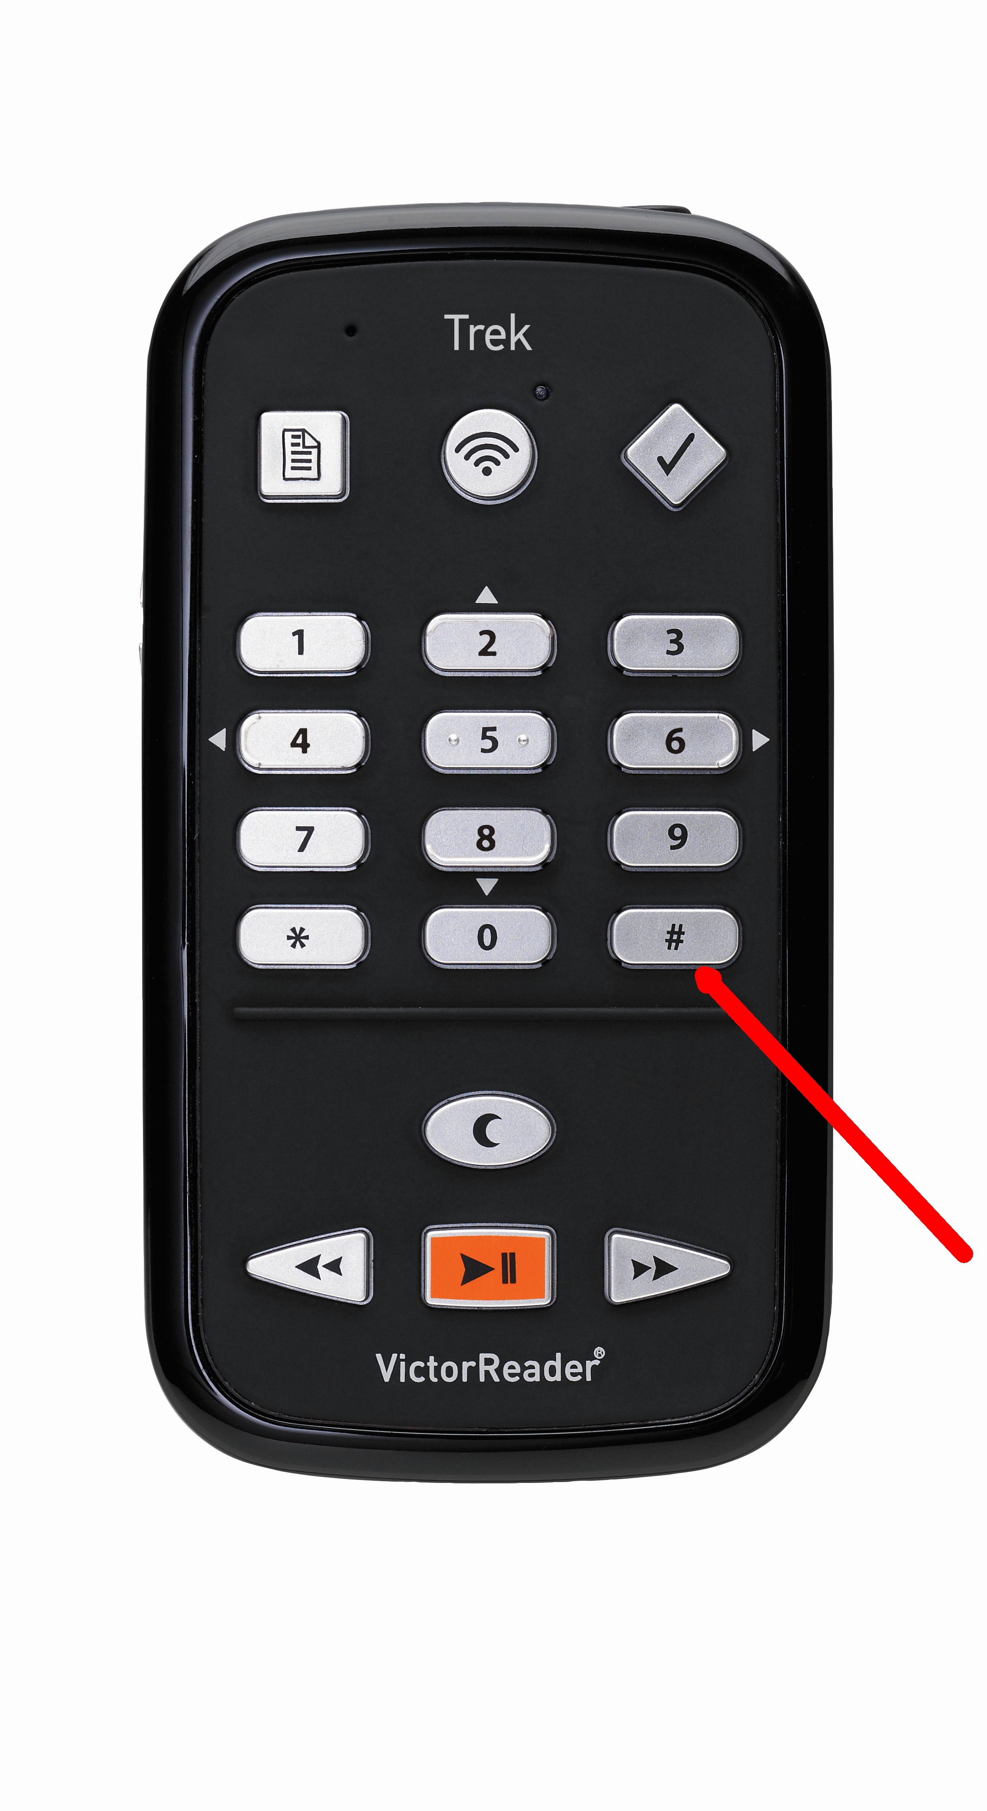
Confirming and Cancelling
Confirm key – Bottom right key on numeric keypad
Note: Play pause can also be used to confirm most operations, but in some cases there is a difference using one or the other. For consistency, encourage to always use the bottom right as the confirm key.
Cancel key – Bottom left key on the numeric keypad

Slide 19
Adjusting Volume, Speed etc.
Cycle through available options with a quick press of the Power button.
Volume up and down controls each setting.
Different options will be presented in different modes. For example in the Music bookshelf tone and pitch options are replaced with bass and treble options.

Slide 20
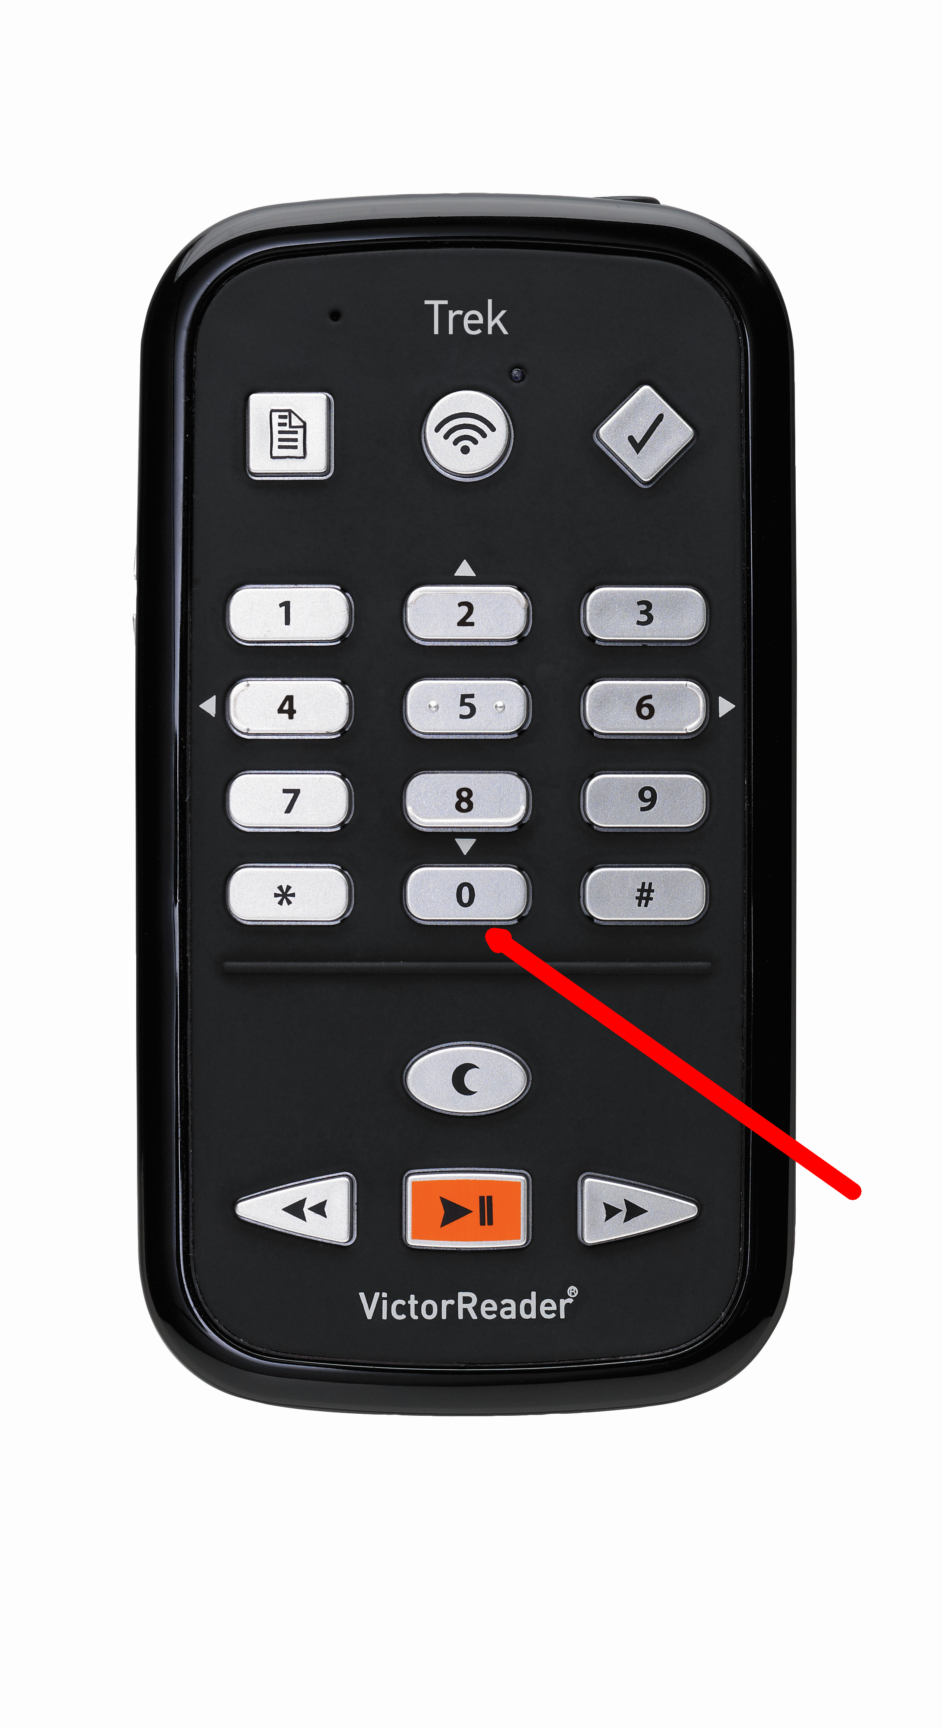
Key Describer
Key describer provides information about the keys and their descriptions
Turn on by holding Key 0 until Trek announces “Key describer on”.
Press any button to hear it’s description and function
Turn off by holding Key 0 until Trek announces “Key describer off”.

Slide 21
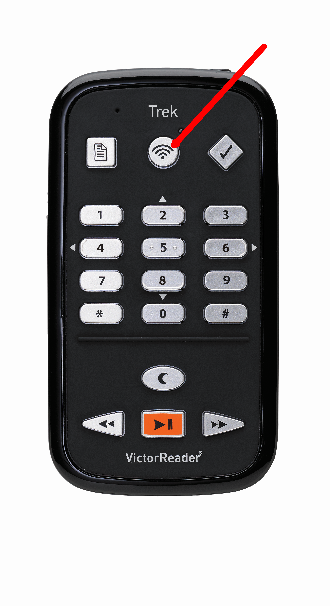
Switching Between Modes
Trek has 3 main modes of use:
Offline bookshelf mode
Online bookshelf mode
Orientation mode
Toggle between modes with the Online button in the middle of the top row of three buttons on the front of the Trek.
Note if GPS is turned on it will continue to track your movement and locate you correctly when you return to GPS mode.

Slide 22
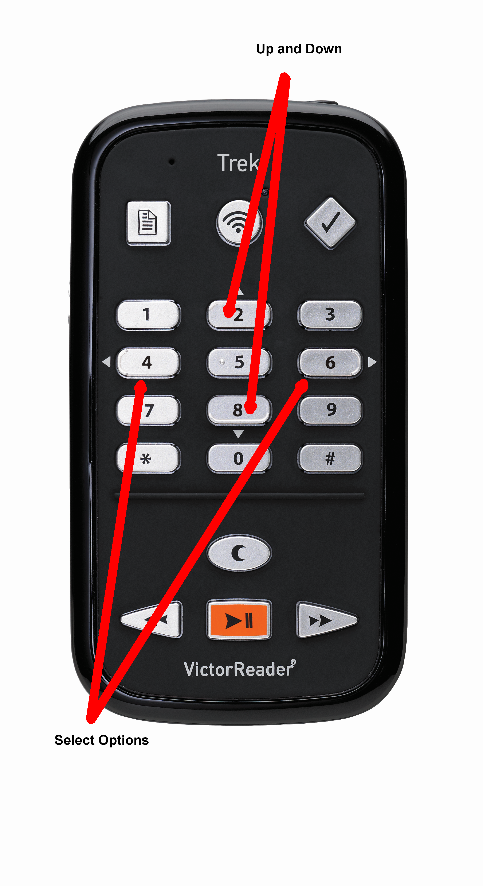
Navigating Menus/Options and Navigation Levels
Key 2 and Key 8 navigate up and down through menu items
Key 4 and Key 6 are used to select options for each menu item
Confirm (bottom right) and Cancel (bottom left)

Slide 23
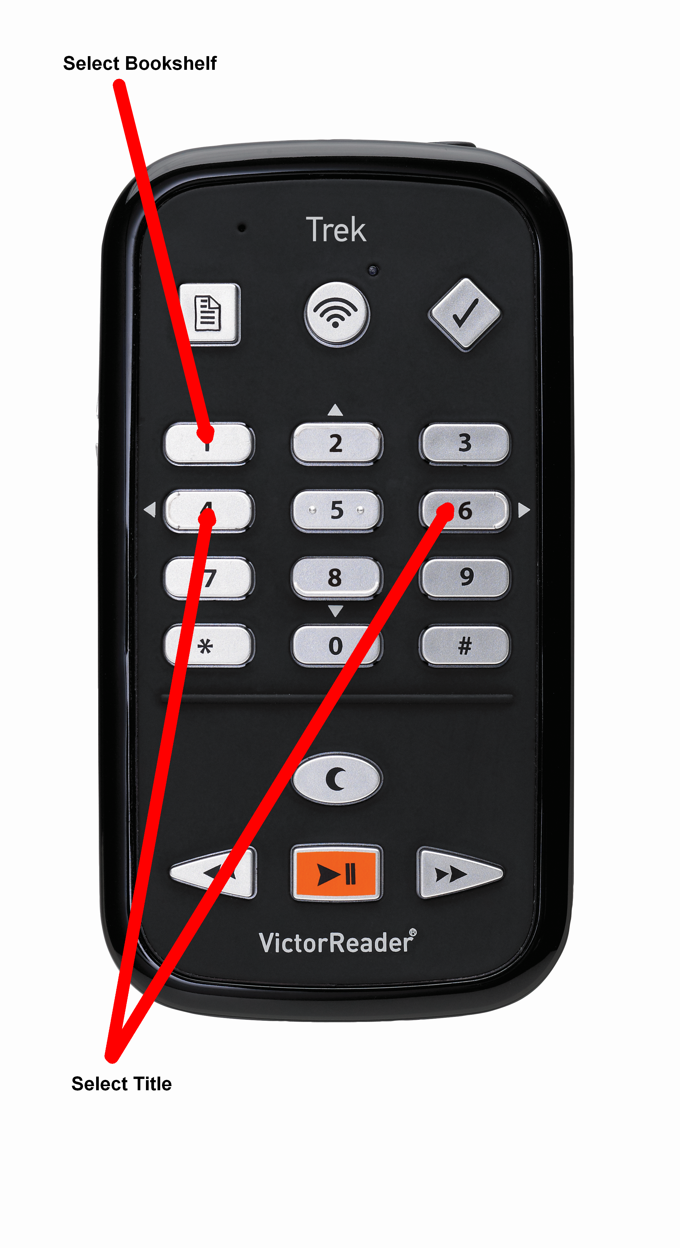
Bookshelf Navigation
In either the Offline bookshelf mode or Online bookshelf mode, the 1 key will cycle between the various bookshelves available.
To navigate titles for a particular source use 4 and 6
Confirm to select a source.

Slide 24
Book Navigation
Depending on the book source, different levels of navigation will be available.
Press and hold fast forward and rewind to skip ahead by unit. The longer it’s held the more time will be skipped.
Use the 2 and 8 keys to select different navigation levels then 4 and 6 to skip by the selected option.

Slide 25
Other Options Available in Books
Bookmarks
Highlight Bookmarks
Audio Bookmarks
Go To Feature
Bookmark Alerts
Where am I Feature
Wikipedia lookup
Wiktionary lookup
Play/Pause included at no extra charge

Slide 26
Settings Menu
Press 7 to enter the settings menu.
Continue to press 7 to cycle through the various available menus
Normal navigation rules apply with Keys 2 4 6 and 8

Slide 27
Text Entry
In case where text entry is required, Trek uses a multi-tap text entry system reminiscent of old school texting on a cellphone before touch screens. (Good times)
Each key is pressed repeatedly until the correct character is selected. Once you pause on the selected character it will enter the character.
Two options for feedback are available in settings:
Announce character on each key press and enter character after pause (recommended
for beginners)
Announce final character only

Slide 28
Key Selection
Key 1: 1, period, comma, question mark, hyphen/dash, backslash, colon, semi-colon, apostrophe, quotation mark, forward slash, less than sign, greater than sign, left square bracket, right square bracket
Key 2: a, b, c, 2
Key 3: d, e, f, 3
Key 4: g, h, i, 4
Key 5: j, k, l, 5
Key 6: m, n, o, 6
Key 7: p, q, r, s, 7
Key 8: t, u, v, 8
Key 9: w, x, y, z, 9
Key 0: space, 0, exclamation mark, at (@) sign, number sign, dollar sign, percent sign, circumflex, ampersand, asterisk, left parentheses, right parentheses, underscore, plus sign, equals sign, pound sign, euro currency sign, yen sign
To toggle between lower case, upper case and numeric modes, press and release the Bookmark key.

Slide 29
Explore Mode
Used to explore your surroundings.
Press Online until you have Orientation Mode selected.
Trek will search for satellites and attempt to acquire a GPS signal.
Press the 5 Key – the “Where am I key” for information about your location.
Information provided while walking or driving:
Address and street information Next intersection
Landmarks within 10 metres

Slide 30
Driving Vs. Walking in Explore Mode
Trek will determine if you are walking or driving based on your speed and adjust verbosity and mapping frequency to your mode of travel.
Next Intersection
Walking – will announce type of intersection (2 way, 3 way etc.) then the current street name followed by the cross street name. Each segment of the intersection is announced in a clockwise manner.
When you are travelling in a vehicle you will only be told the first street crossing and this goes from right to left.
In both modes there will a beep to indicate when an intersection has been detected.
Press the right arrow button to hear the next intersection

Slide 31
What’s Around?
The What’s Around feature is used to obtain information about points of interest (POI) and landmarks in your current vicinity. POI are commercial points built into the map. Landmarks are personal points that you have recorded manually.
To activate press and hold Key 5 – the “Where Am I key”.
You will be presented with a list of item (if there are any) and Trek will tell you if they are to your left or right.
Use Keys 4 and 6 to move through the items.
Press the Confirm key to navigate to a selected location in pedestrian mode or press and hold the confirm key for guidance in vehicular mode.

Slide 32
What’s Around? – Extended Search
One item that’s available on the What’s Around list of items is “Extended Search”. Press confirm to select this.
You will be presented with a list of categories:
• Landmarks
• Transportation
• Food
• Banking
• Health
• Shopping
• Lodging
• Education
• Public Administration
• Automotive
• All

Slide 33
What’s Around? – Extended Search
On the list of categories use Keys 2 and 8 to move through the list, Confirm to select.
This will present a list of up to 50 points of interest found within 8KM.
Use 4 and 6 to move through this list.
Short press Confirm for pedestrian guidance or long press Confirm for vehicular guidance.
Manually exit the What’s Around feature by hitting Cancel

Slide 34
Working with Addresses
In Orientation mode, press and release the Go To button. You will be placed in a list of your saved landmarks. Press 4 you will hear “Enter and Address”. Press the Confirm key.
You will be prompted “Select a State” and will be presented with a list of all available States for your installed maps. Keys 4 and 6 will move through the list. If there is an active GPS section your current state should automatically be detected. Press the Confirm Key once you have selected your state.
You will be prompted “Enter city name” This will default to your last city entered which you can select with the Confirm key. Alternatively use the text entry method to enter the city name and hit Confirm.
You will be presented with a list of results for the entered city name. Use Keys 4 and 6 to select the city then hit Confirm.
The same process will repeat for Street Name and Civic Number (The address). Once all data has been entered you can press confirm for pedestrian instructions or long press for vehicular instructions. Hit Cancel to return to any previous entry.

Slide 35
Recording Landmarks
Hit Key 5 to verify that you have a good GPS signal and that you are correctly located.
Press and release the Record button.
You will be prompted to provide a description of the landmark and will then have 4 seconds to speak a description. After 4 seconds a double beep will indicate the end of the landmark creation.
The recorded landmark is stored on the Trek and will be kept in the list of possible destinations.

Slide 36
Recording a Route
A route is a sequence of steps that you follow to get from one point to another.
Routes can only be recorded in pedestrian mode.
Hit Key 5 to verify that you have a good GPS signal and that you are correctly located.
Press and hold the Record button then confirm Route Recording by pressing the confirm button.
Trek will prompt you to speak a name for a route and you will have 4 seconds to name it. It is advised to make the name meaningful like “home to work.”
Walk the route. Trek will beep every 60seconds to confirm the route is being recorded.
When you have recorded a route, you can then recall and follow the route.

Slide 37
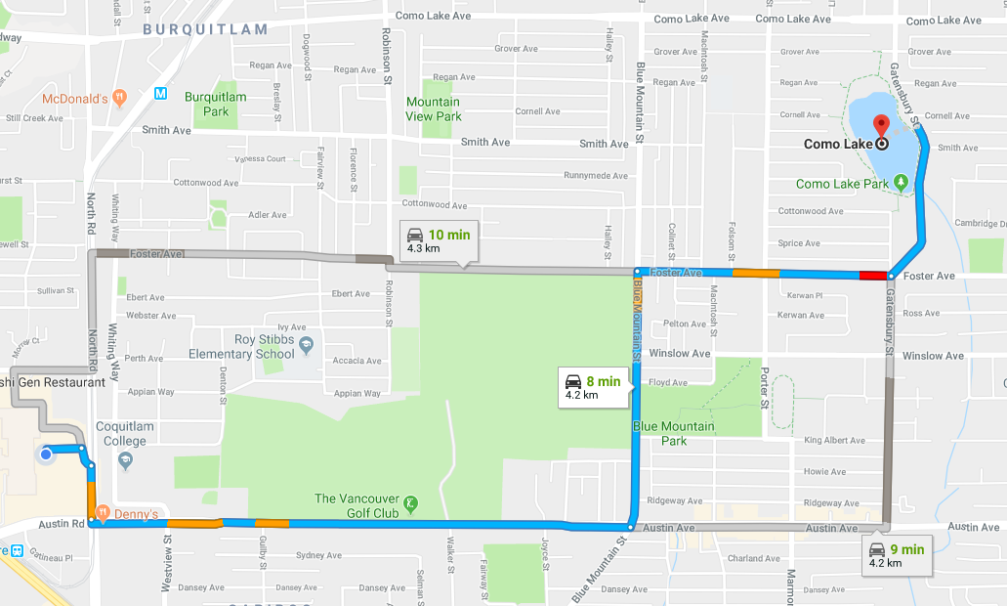
Recalling and Following a Route
Press and hold the Go To Button (Top left corner)
Use 4 and 6 to select your desired route
Press the Confirm Key to select the route.
Press the Confirm Key again to start.

Slide 38
Reversing a Route
Press and hold the Go To Button (Top left corner)
Use 4 and 6 to select your desired route
Press the Confirm Key to select the route.
Press and hold the Confirm Key to select the route and reverse the start and finish points.

Slide 39
Previewing a Route
When you are following an active route you can preview the next instruction by pressing the Right arrow button. You can keep previewing by continuing to press Right.
Press left to return to the previous instruction.
Return to normal guidance by pressing the Confirm key.

Slide 40
What if I Deviate?
No Judgements Here!
If you go off route, Trek will tell you so and ask if you want to be rerouted to your destination. Press the Confirm key to reroute guidance.
If you deviate off into an open area with no map data, like a park, instructions will be given based on clock directions. For example “Off-route: Turn at 3 o’clock to come back to the route.” It will continue to give you directions until you return to your route.

Slide 41
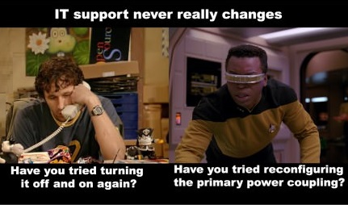
What if There’s a Problem? AKA, Have you Tried Turning it off and on Again?
1 – Try to power off an on.
2 – Try a reset. Hold the Power button down for seven seconds
3 – Remove the battery and reinsert it.
4 – Call Ryan

Slide 42
Let’s Go Trekking!

